Slide 1
Mapping biodiversity knowledge loss in the Amazon due to historical and future deforestation
Bruno Umbelino
Supervisory Team: Dr. Ana Malhado, Dr. Juliana Stropp, Dr. Ricardo Correia
23rd Meeting of GBIF
26 and 27 of October of 2016
Brasília - Brazil

Slide 2
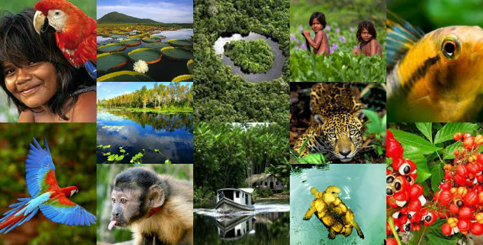
Why the Amazon?
Source: www.defesaaereanaval.com.br
Context
Goals
Procedures
Preliminary results
We hope...
Notes:
Fonte da imagem: http://www.defesaaereanaval.com.br/corredor-ecologico-triplo-a-o-pesadelo-da-perda-da-amazonia-existe-e-agora-tem-mapa-programa-e-justificativa/

Slide 3
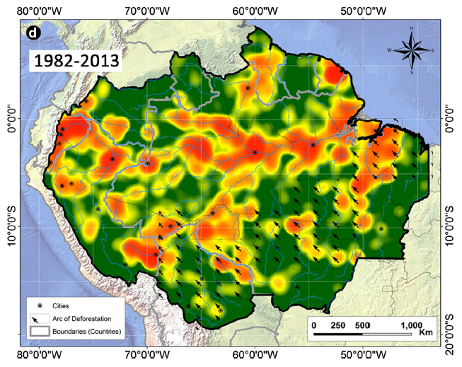
What do we know?
Source: dos Santos et al. 2015. Biodivers Conserv
Context
Goals
Procedures
Preliminary results
We hope...

Slide 4
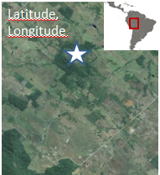
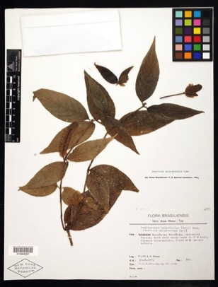
What do we lose?
1) Knowledge loss through time¹
Quality of information degrades with time:
Justicia polystachia
Identified
Actual species occurrece?
Identification
updated
Collected
1971
1972
1998
2015
¹Ladle & Hortal 2013. Front Biogeog
Context
Goals
Procedures
Preliminary results
We hope...

Slide 5
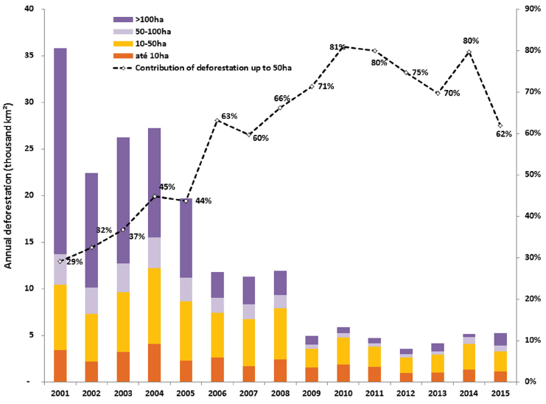
What do we lose?
2) Forest loss
Source: Montinho et al. 2016. Jour. Elementa.
Context
Goals
Procedures
Preliminary results
We hope...

Slide 6
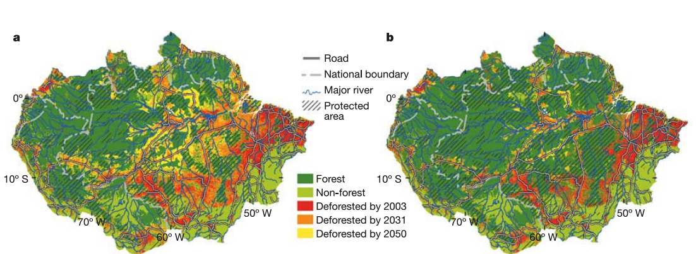
What do we lose?
Deforestation scenarios
Business as usual
Governance
Source: Soares-Filho et al. 2006. Nature.
Context
Goals
Procedures
Preliminary results
We hope...

Slide 7
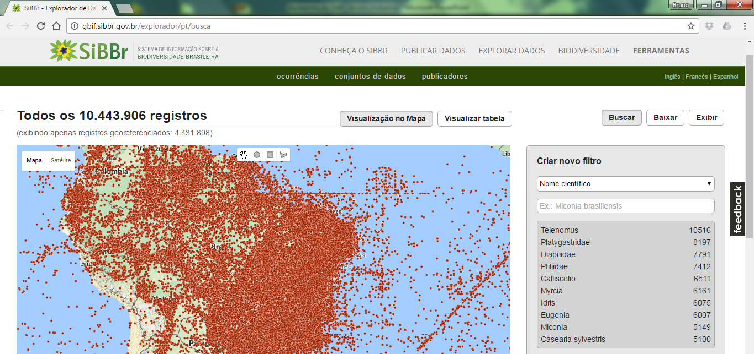
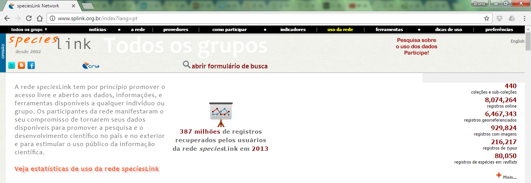
Research questions:
How does knowledge of Amazonian biodiversity accumulate and degrade with time?
Inventory completeness will be estimated^{1,2}
¹Stropp et al. 2016. Global Ecol. Biogeogr
² Yang et al. 2013. Jour. Biogeogr
Context
Goals
Procedures
Preliminary results
We hope...

Slide 8
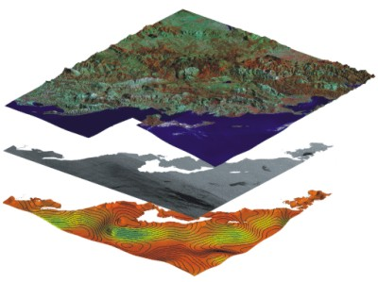
2) How much biodiversity knowledge has already been lost due to deforestation and will be lost to continued deforestation?
Species occurrence
Historical deforestation
Future deforestation
Context
Goals
Procedures
Preliminary results
We hope...
Notes:
Identify and estimate the size of area that have never been inventoried and that have been subject to historical deforestation or are predicted to be deforested in the near future.

Slide 9
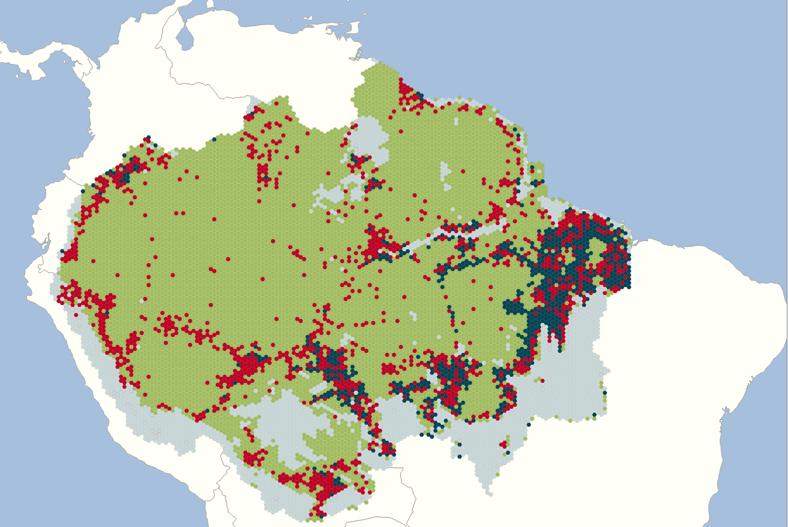
Current scenario
> 50% of records in deforested areas
Deforested areas with NO records
Context
Goals
Procedures
Preliminary results
We hope...
Notes:
-> Colocar cenário atual e futuro
Células em preto: desmatamento e número de registros igual a zero.

Slide 10
This methodology can help us:
Prioritize conservation actions;
Intensify studies in poorly studied areas;
Help environmental legislation.
Context
Goals
Procedures
Preliminary results
We hope...

Slide 11
brunosilvasantos27@gmail.com

