Slide 1

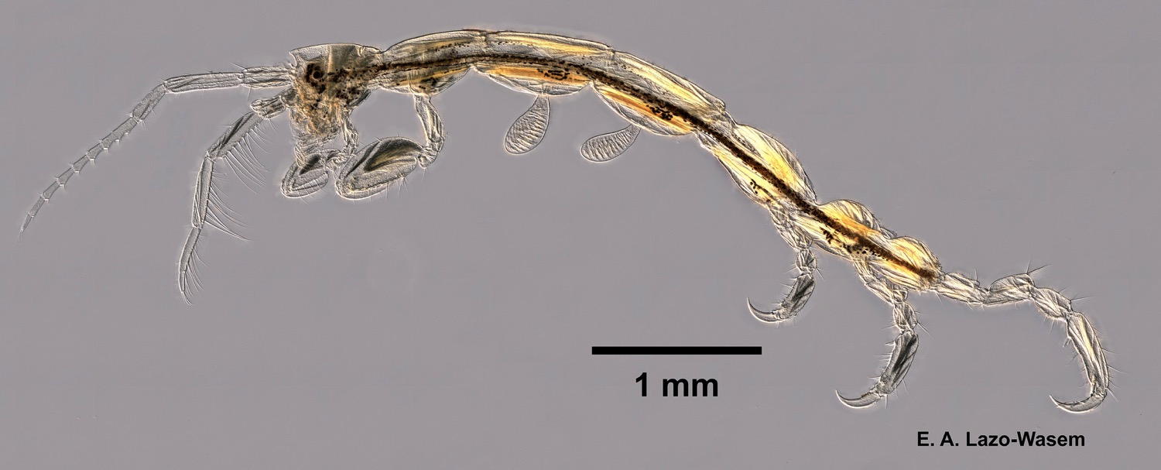
Overview
Skeleton shrimp (Caprella penantis), collected along rocks on the southeast side of Horse Island, Connecticut, Long Island Sound, USA, 9 Aug 2017.
Photo CC0 by Eric A. Lazo-Wasem. From Invertebrate Zoology Division, Yale Peabody Museum https://www.gbif.org/occurrence/1586887860.
September 2017

Slide 2

BY THE NUMBERS
1 Sept 2017
Species occurrence records
Datasets
797,637,656
35,958
Country Participants
Organizational Participants
Publishers
54
40
1,065
Records downloaded per month (avg Jan-Aug 2017)
Total page views (Aug)
43.4 billion
97,053
Notes:
Useful to see GBIF in its different modalities:
A window on biodiversity
An informatics infrastructure focuseD on tools and standards in service to science and society
A global network on bioinformatics

Slide 3
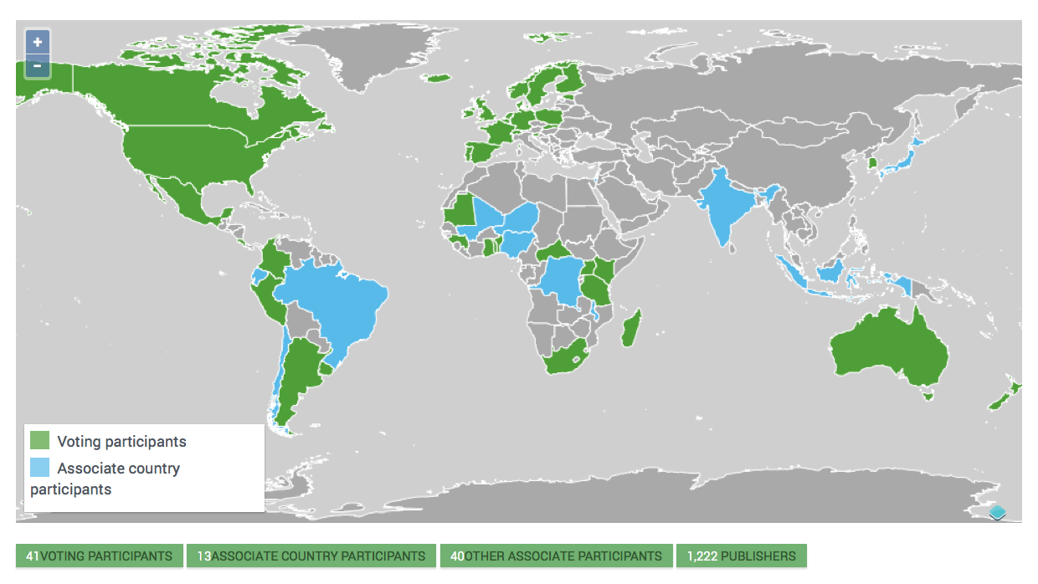
Current network
participation
https://demo.gbif.org/the-gbif-network

Slide 4
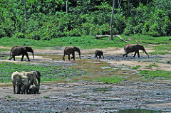
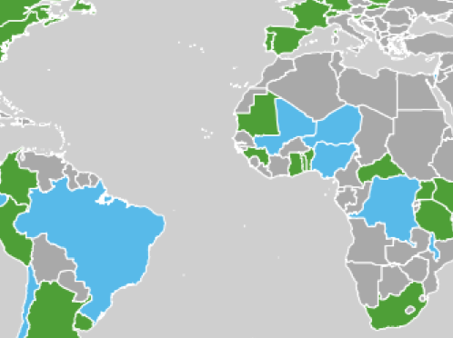
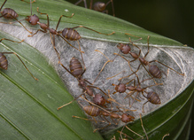
Latest news
communications
      Central African Republic becomes newest GBIF Voting Participant
      Increased commitment aims to improve data access, knowledge and understanding of country’s poorly documented biodiversity and threatened ecosystems
      Read more
      Top tip: The GBIF network: country by country, region by region
      New network page lets users navigate essential details about Participant countries and organizations, and non-members, too.
      Read more
      Prioritizing content mobilization in the GBIF network
      Call for stakeholders to prioritize mobilization efforts in three key areas: geospatial gaps, sampling-event data, and natural history collections
      Read more
https://demo.gbif.org/resource/search?contentType=news
Photo credits: (left) Forest elephants (Loxodonta cyclotis) in the Dzanga Sangha Reserve, Central African Republic. Photo by Peter Prokosch via GRID Arendal, licensed under CC BY-NC-SA 2.0. (right) A colony of weaver ants (Oecophylla smaragdina). Photo by budak licensed under CC BY-NC 4.0..

Slide 5
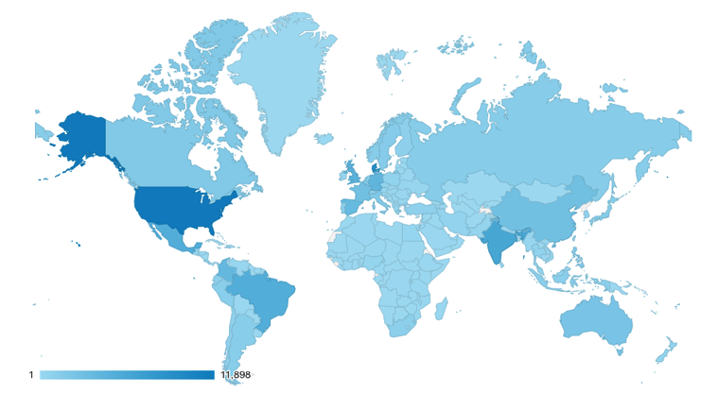
Web traffic to GBIF.org, 2017
Rank | Country/Territory | Sessions | % Total Sessions | 2016 rank | Pages / Session
1 | United States | 145,567 | 12.87% | 1 | 5.01
2 | India | 91,481 | 8.09% | 2 | 2.42
3 | Mexico | 46,144 | 4.08% | 3 | 7.25
4 | Brazil | 45,006 | 3.98% | 5 | 4.77
5 | United Kingdom | 44,819 | 3.96% | 4 | 5.99
6 | Germany | 43,118 | 3.81% | 7 | 4.82
7 | Spain | 41,843 | 3.70% | 6 | 5.12
8 | France | 34,832 | 3.08% | 8 | 4.13
9 | Colombia | 32,760 | 2.90% | 9 | 5.68
10 | Australia | 23,911 | 2.11% | 13 | 3.88
data access and use

Slide 6
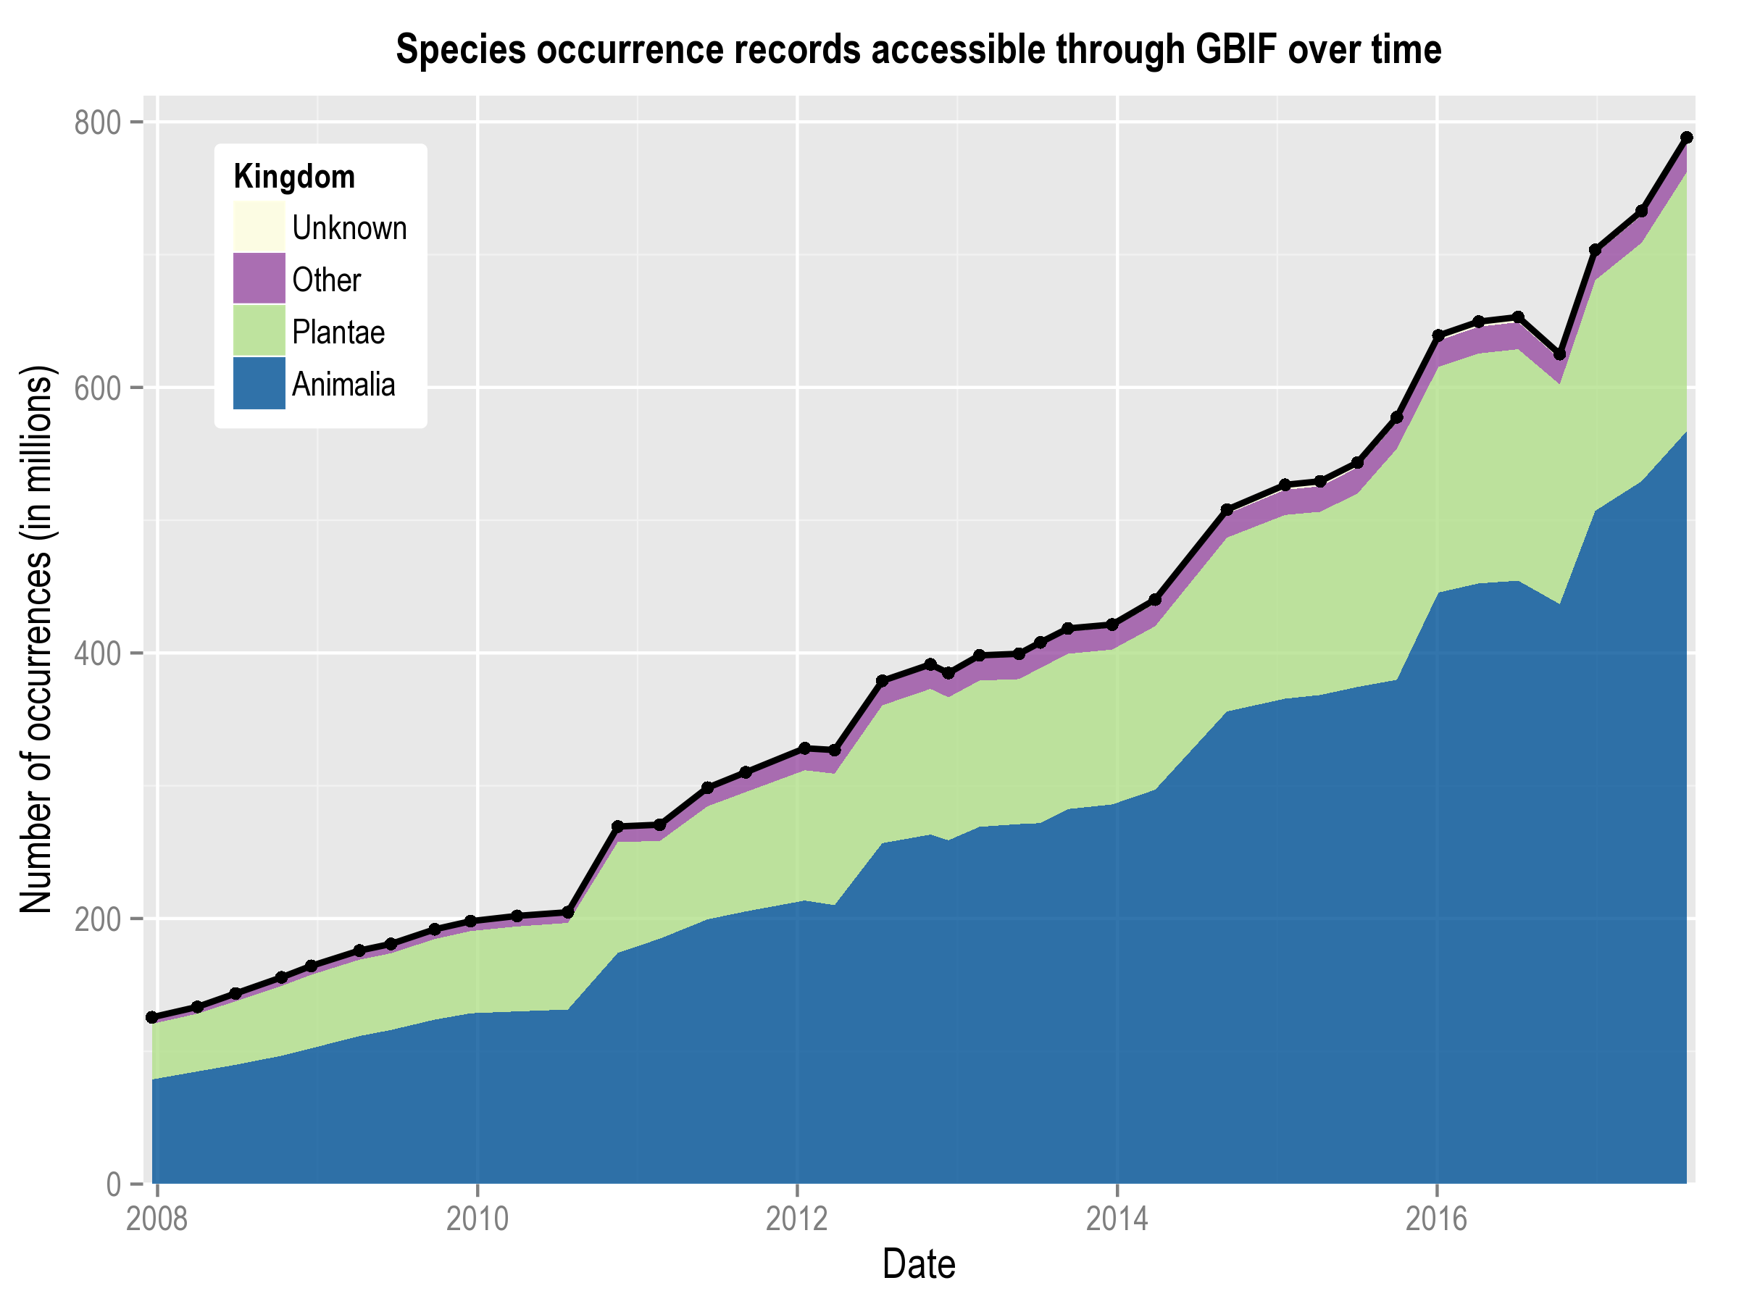
Data published through GBIF.org
data availability
www.gbif.org/analytics/global

Slide 7
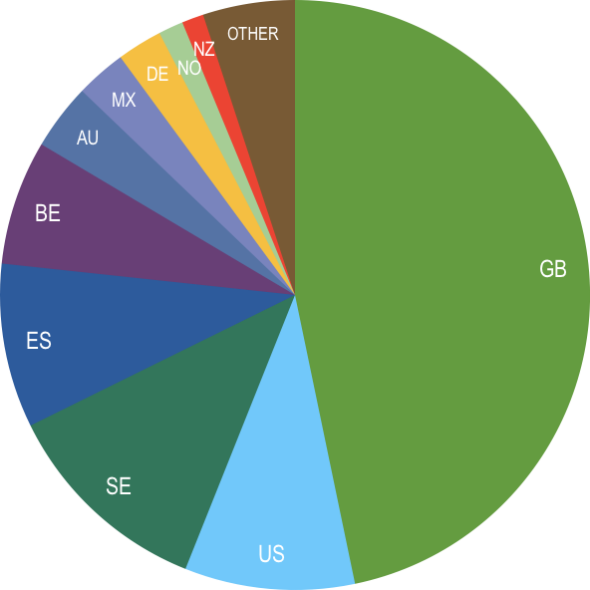
Occurrence records published during 2017 by country as of 31 Aug 2017
 | Country | New records | Jul-17 rank
1 | United Kingdom | 59,462,652 | 1
2 | United States | 14,599,475 | 2
3 | Sweden | 11,847,209 | 3
4 | Spain | 11,451,395 | 4
5 | Belgium | 8,630,814 | 5
6 | Australia | 4,570,041 | 6
7 | Mexico | 3,516,388 | 7
8 | Germany | 3,079,611 | 8
9 | Norway | 1,697,240 | 9
10 | New Zealand | 1,515,354 | 10
data availability
http://www.gbif.org/country

Slide 8
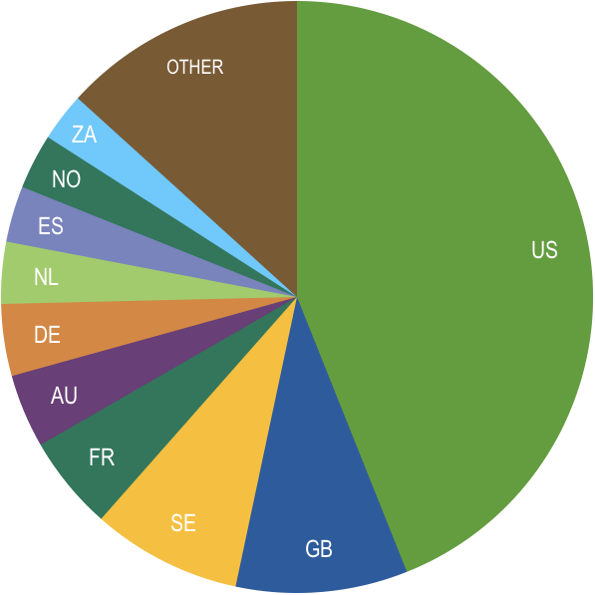
Total number of occurrence records published by country as of 31 Aug 2017
1 | United States | 350,352,456
2 | United Kingdom | 74,814,012
3 | Sweden | 65,282,227
4 | France | 40,530,124
5 | Australia | 32,039,856
6 | Germany | 31,211,265
7 | Netherlands | 26,952,024
8 | Spain | 24,416,570
9 | Norway | 24,049,316
10 | South Africa | 21,164,432
data availability
http://www.gbif.org/country

Slide 9
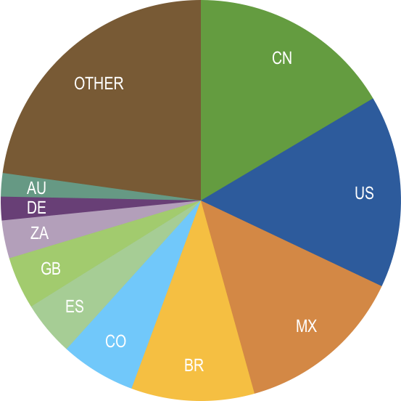
Data download requests by country, 2017 as of 31 Aug 2017
 | Country | Downloads | Jul-17 rank
1 | China | 11,687 | 2
2 | United States | 11,012 | 1
3 | Mexico | 9,672 | 3
4 | Brazil | 7,056 | 4
5 | Colombia | 4,310 | 5
6 | Spain | 3,126 | 6
7 | United Kingdom | 2,991 | 7
8 | South Africa | 2,167 | 8
9 | Germany | 1,350 | 9
10 | Australia | 1,337 | 11
data access and use

Slide 10
data access and use
Peer-reviewed publications using GBIF-mediated data
through 31 August 2017

Slide 11
Peer-reviewed uses, by country and region, 2017
Total # of peer-reviewed papers by country
1 | United States | 128
2 | United Kingdom | 58
3 | Brazil | 54
4 | Germany | 48
5 | Australia | 44
6 | Mexico | 40
6 | Spain | 40
8 | China | 33
9 | Canada | 30
10 | France | 27
data access and use
Total # of papers by region
1 | Europe | 374
2 | Latin America | 169
3 | North America | 158
4 | Asia | 101
5 | Oceania | 53
6 | Africa | 36

Slide 12
Featured research
Aug 2017
1/3
 | Bicknell JE, Collins MB, Pickles RSA et al. (2017) Designing protected area networks that translate international conservation commitments into national action. Biological Conservation. doi:10.1016/j.biocon.2017.08.024 Author countries: United Kingdom, Canada, Guyana, Australia
 | Bowler DE, Hof C, Haase P et al. Cross-realm assessment of climate change impacts on species’ abundance trends. Nature Ecology & Evolution. doi:10.1038/s41559-016-0067 Author countries: Germany, Belgium, United Kingdom, United States, Spain, Netherlands, Switzerland
 | Caudullo G, Welk E & San-Miguel-Ayanz J (2017) Chorological maps for the main European woody species. Data in Brief 12: 662-666. doi:10.1016/j.dib.2017.05.007 Author countries: Italy, Germany
 | Filazzola A, Sotomayor DA & Lortie CJ (2017) Modelling the niche space of desert annuals needs to include positive interactions. Oikos. doi:10.1111/oik.04688 Author country: Canada
 | Fonseca É, Solé M, Rödder D & de Marco P (2017) Pet snakes illegally marketed in Brazil: Climatic viability and establishment risk. PLoS ONE 12(8): e0183143. doi:10.1371/journal.pone.0183143 Author countries: Brazil, Germany
data access and use
Invasive alien species
Impact of climate change
Species conservation and protected areas
Biodiversity and human health
Food, farming and biofuels
Ecosystem services
Advancing biodiversity science
Data management
Data papers
https://demo.gbif.org/resource/search?contentType=literature&literatureType=journal

Slide 13
Featured research
Aug 2017
2/3
 | Gallardo B, Aldridge DC, González-Moreno P et al. (2017) Protected areas offer refuge from invasive species spreading under climate change. Global Change Biology. doi:10.1111/gcb.13798 Author countries: Spain, United Kingdom, Czech Republic, South Africa, France
 | Giannini TC, Costa WF, Cordeiro GD et al. (2017) Projected climate change threatens pollinators and crop production in Brazil. PLoS ONE 12(8): e0182274. doi:10.1371/journal.pone.0182274 Author countries: Brazil, Netherlands, Argentina
 | Golding N, August TA, Lucas TCD, Gavaghan DJ, van Loon EE & McInerny G (2017) The zoon R package for reproducible and shareable species distribution modelling. Methods in Ecology and Evolution. doi:10.1111/2041-210X.12858 Author countries: Australia, United Kingdom, Netherlands
 | Grainger MJ, Ngoprasert D, McGowan PJK & Savini T (2017) Informing decisions on an extremely data poor species facing imminent extinction. Oryx. doi:10.1017/s0030605317000813 Author countries: United Kingdom, Thailand
 | Lozano V, Chapman D & Brundu G (2017) Native and non-native aquatic plants of South America: comparing and integrating GBIF records with literature data. Management of Biological Invasions 8(3): 443-454. doi:10.3391/mbi.2017.8.3.18 Author countries: Italy, United Kingdom
data access and use
Invasive alien species
Impact of climate change
Species conservation and protected areas
Biodiversity and human health
Food, farming and biofuels
Ecosystem services
Advancing biodiversity science
Data management
Data papers
https://demo.gbif.org/resource/search?contentType=literature&literatureType=journal

Slide 14
Featured research
Aug 2017
3/3
 | Oliveira U, Soares-Filho BS, Paglia AP et al. (2017) Biodiversity conservation gaps in the Brazilian protected areas. Scientific Reports 7: 9141. doi:10.1038/s41598-017-08707-2 Author countries: Brazil, Argentina, Singapore
 | Poore AGB, Ahyong ST, Lowry JK & Sotka EE (2017)Plant feeding promotes diversification in the Crustacea. Proceedings of the National Academy of Sciences 114(33): 8829-8834. doi:10.1073/pnas.1706399114 Author countries: Australia, United States
 | Tingstad L, Gjerde I, Dahlberg A & Grytnes JA (2017) The influence of spatial scales on Red List composition: Forest species in Fennoscandia. Global Ecology and Conservation 11: 247-297. doi:10.1016/j.gecco.2017.07.005 Author countries: Norway, Sweden
 | Troudet J, Grandcolas P, Blin A, Vignes-Lebbe R & Legendre F (2017) Taxonomic bias in biodiversity data and societal preferences. Scientific Reports 7: 9132. doi:10.1038/s41598-017-09084-6 Author country: France
 | Walsh MG, Wiethoelter A & Haseeb MA (2017) The impact of human population pressure on flying fox niches and the potential consequences for Hendra virus spillover. Scientific Reports 7: 8226. doi:10.1038/s41598-017-08065-z Author countries: Australia, United States
data access and use
Invasive alien species
Impact of climate change
Species conservation and protected areas
Biodiversity and human health
Food, farming and biofuels
Ecosystem services
Advancing biodiversity science
Data management
Data papers
https://demo.gbif.org/resource/search?contentType=literature&literatureType=journal

