Slide 1
The Biodiversity Information for Development (BID) programme
Tim Hirsch, Deputy Director, GBIF Secretariat
Side event on mobilizing biodiversity data for policy making in africa, cbd cop13, cancún, 6th december 2016

Slide 2
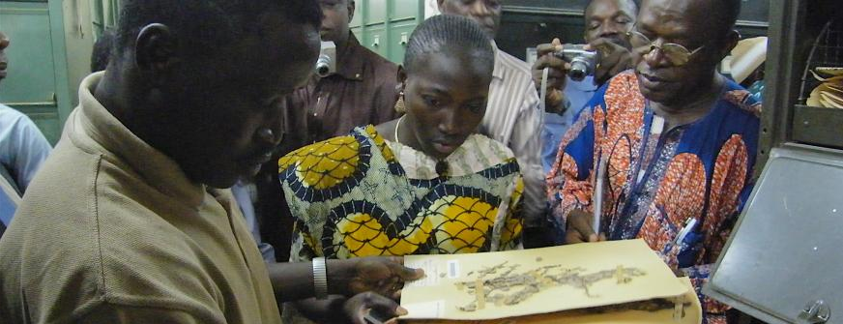
What is the bid programme?
Four-year programme, 2015-2018
Funded by EU, run by Global Biodiversity Information Facility (GBIF)
Aims to increase biodiversity information available in Africa, Caribbean, Pacific
Supports capacity enhancement, mobilization of data, strengthening networks
Focus on data to support policy needs (invasives, protected areas, threatened species)
www.gbif.org/bid

Slide 3
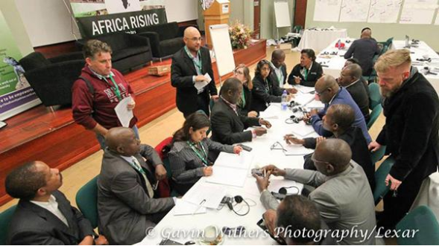
‘africa rising’ conference
Launch event for BID Africa, Kirstenbosch Botanical Garden, May 2015
Nearly 100 delegates from national agencies, research institutions, international organizations
Joint funding from JRS Biodiversity Foundation, SANBI, UNEP-WCMC
‘Declaration on biodiversity information for sustainable development in Africa’
http://www.gbif.org/newsroom/news/idb-2015

Slide 4
Bid programme timetable
Three project call periods
First Africa call (Sep 2015-June 2016)
Parallel calls in Caribbean and Pacific (under way)
Second Africa call (February 2017)
http://www.gbif.org/newsroom/news/idb-2015

Slide 5
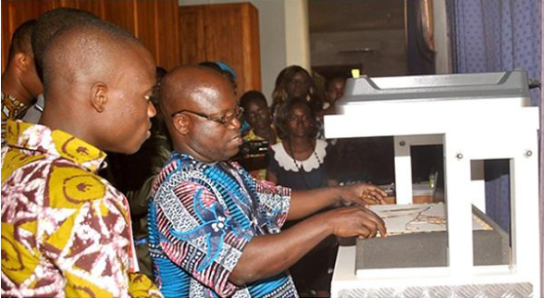
Bid grant types
Three types of project supported by programme
Small data mobilization projects (single institutions)
National grants (establish/strengthen national biodiversity information facilities)
Regional consortia (three or more ACP countries), collaborations to increase biodiversity data mobilization
http://www.gbif.org/newsroom/news/idb-2015

Slide 6
Bid africa phase 1
Great response!
143 concept notes submitted from 34 African countries
Tough 2-stage selection procedure
http://www.gbif.org/newsroom/news/idb-2015

Slide 7
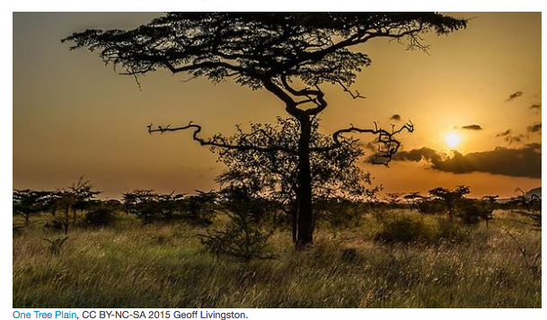
Bid africa phase 1
23 projects covering 20 sub-Saharan African countries
10 small grants, 10 national projects, three regional consortia
Total grant value €972k
www.gbif.org/bid

Slide 8
Bid africa phase 1: National projects
www.gbif.org/bid

Slide 9
Bid africa phase 1: National projects
www.gbif.org/bid

Slide 10
Bid africa phase 1: regional projects
www.gbif.org/bid

Slide 11
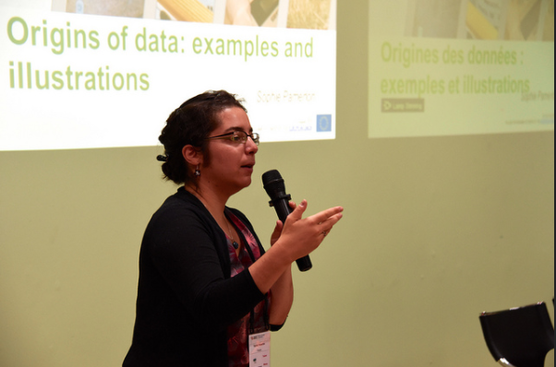
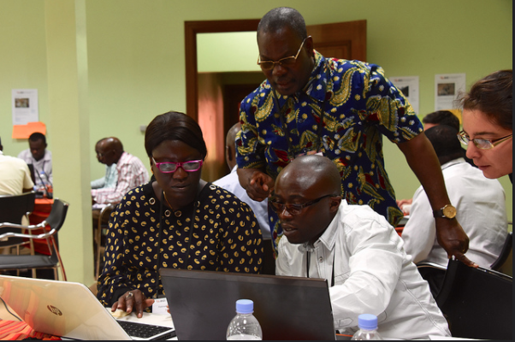
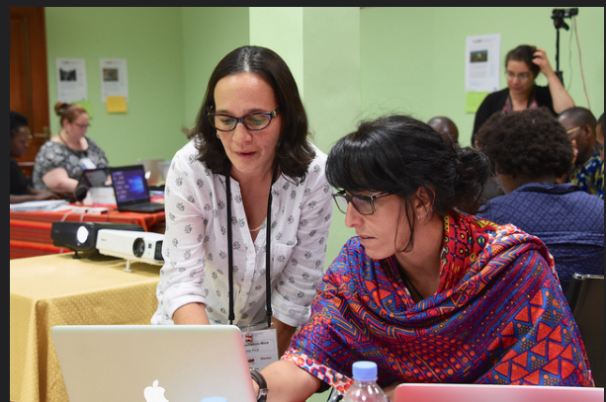
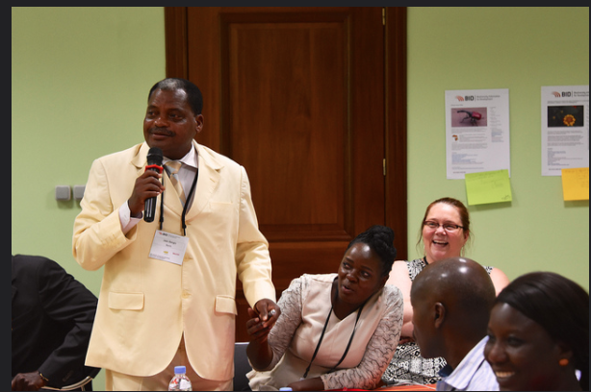
Building a community of practice
Training workshop for funded projects, Kigali, Rwanda, August 2016
Trainers and mentors from Colombia, Costa Rica, Belgium, United States
Multilingual re-usable materials available for future training
Online edition for small grants
www.gbif.org/bid

Slide 12
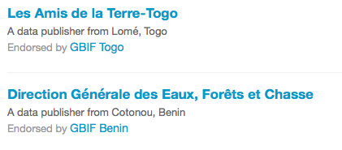
Data already flowing!
www.gbif.org/bid

Slide 13
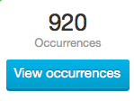
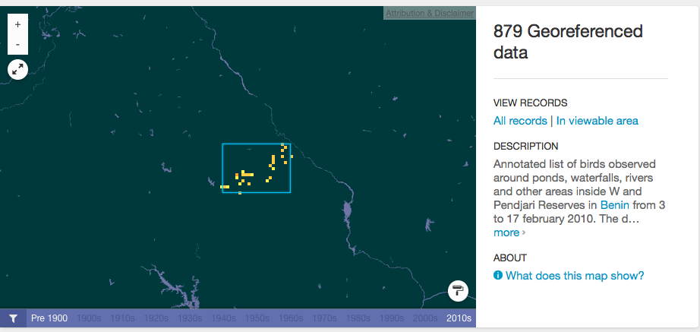
Data already flowing!
http://www.gbif.org/dataset/025769ee-df28-40de-bead-69fe1259bbad

Slide 14
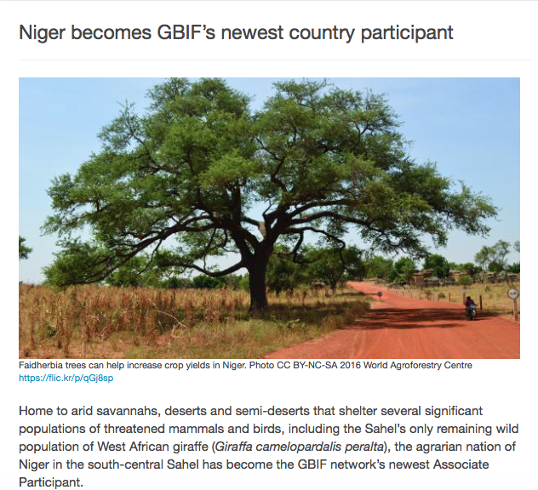
Expanding the network
http://www.gbif.org/newsroom/news/niger-joins-gbif-network

Slide 15
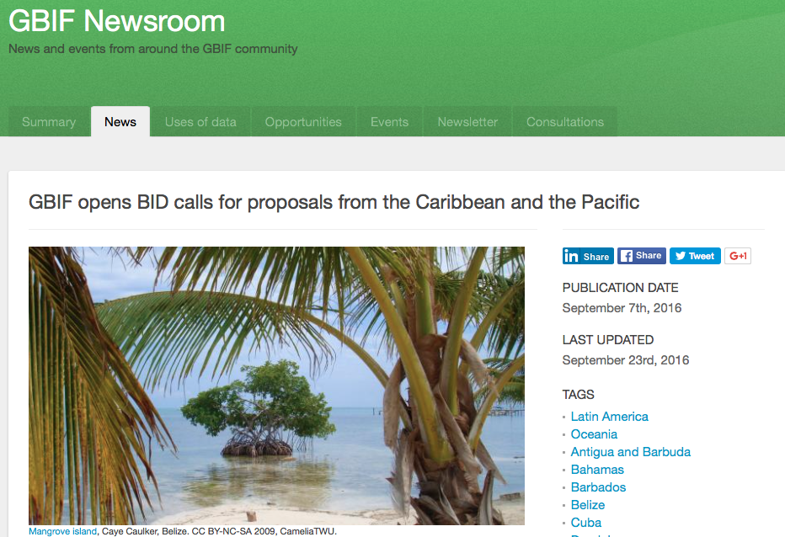
Next steps
Selection of projects in Caribbean, Pacific
Launch of Africa 2nd call, Feb 2017
http://www.gbif.org/dataset/025769ee-df28-40de-bead-69fe1259bbad

Slide 16
Thank you!
thirsch@gbif.org
Sign up to BID mailing list: http://bid.gbif.org/

